Slide 1
CMSC201
Computer Science I for Majors
Lecture 25 – Final Exam Review

Slide 2
Office Hours
Tuesday (December 13th) is the last
day office hours will be held
Study Day is Wednesday (December 14th)

Slide 3
Exam Rules
The final is closed everything:
  No books
  No notes
  No cheat sheets
  No laptops
  No calculators
  No phones

Slide 4
Exam Rules
Place your bookbag under your desk/chair
  NOT on the seat next to you
You may have on your desk:
  Pens, pencils, erasers
  Water bottle
  UMBC ID
    You must bring your UMBC ID with you to the exam! We won’t accept your test without it.

Slide 5
Exam Rules
DO NOT CHEAT!!!
Cheating will be dealt with severely and immediately
  If a TA or instructor sees you looking at another student’s paper they may take your test from you
Your TA or instructor may ask you to move at any time during the test
  This doesn’t mean we think you’re cheating

Slide 6
Exam Time
Final Exam will held be on Thursday,
December 15th from 3:30 PM to 5:30 PM
If you need SDS accommodations, you must request them and notify us ASAP

Slide 7
Exam Locations
Being held in five separate rooms
    FA 215 - Sections 9, 15, 18
    FA 306 - Sections 12, 17, 20, 24
    ENGR 027 - Sections 2, 4, 6, 8, 14, 16, 22, 23, 27, 30
    PAHB 132 - Sections 3, 10, 21, 26
    PUP 105 - Sections 5, 11, 28, 29
Make sure you go to the correct room!

Slide 8
Exam Seating
Space allowing, you will sit every other seat, so that you are not next to another student
The proctor may have specific instructions for the seating arrangement in your room
Make sure you know how to get to your exam room location – arrive early if possible!
  Locate your room ahead of time

Slide 9
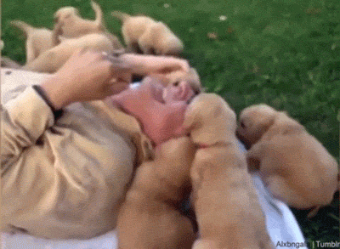
Questions about Exam Rules?

Slide 10
Exam Format
Similar to the midterm
  Going over the slides and making sure you are comfortable with the material would be a good idea
  Try some of the exercises and practice examples available in the slides

Slide 11
Exam Format
Multiple Choice
True/False
Code evaluation
  Given code, what does it do?

Slide 12
Exam Format
Debugging
  Find and fix errors
Fill in the blank
  Complete a piece of partially-written code
Programming problems
  Similar to work from assignments and labs

Slide 13
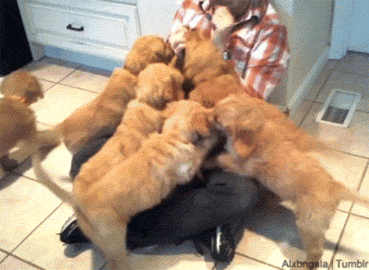
Questions about Exam Format?

Slide 14
Exam Content
Everything we covered at the beginning!
From the midterm, you should be familiar with:
  Evaluating expressions
  Control structures
    For Loops
    While Loops (including Interactive loops)
    If/Elif/Else
  Decimal <-> Binary conversion

Slide 15
Exam Content
From the midterm, you should be familiar with:
  Lists
    Indexing (including negative indexing)
    Appending
  Debugging
  Strings
    String functions like split() and strip()
  Functions
    Passing and returning variables

Slide 16
Exam Content
Everything else we’ve covered so far!
You should be especially familiar with:
  File I/O
  Data structures
    Tuples
    Dictionaries
  Recursion
    Recursion
      Recursion

Slide 17
Exam Content
You should be especially familiar with:
  Algorithms and analysis
    Searching algorithms
      Linear & Binary
    Sorting algorithms
      Selection Sort, Bubble Sort, & Quicksort
  Multi-dimensional lists
    2D and 3D lists
    Printing, creating, copying
You should understand how they work, and know their run times.

Slide 18
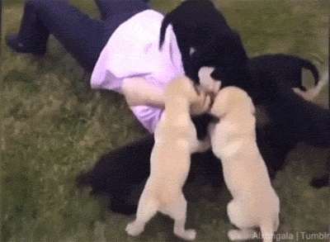
Questions about Exam Content?

Slide 19
Exam Advice
Write down your name and circle your section
Flip through the exam and get a feel for the length of it and the types of questions
If a problem is unclear or you think there is an error on the exam, raise your hand

Slide 20
Exam Advice
Some questions have partial credit
  You should at least attempt every problem
  If you don’t know how to do one part of the problem, skip it and do the rest
  Make sure to pace yourself – this exam is longer than the midterm!

Slide 21
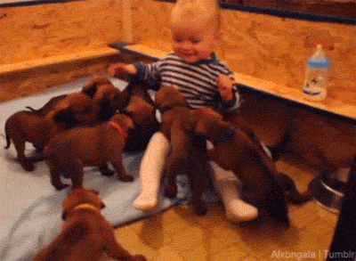
Any Other Questions?

Slide 22
Announcements
Project 2 out now
  Due on Tuesday, December 13th
Survey #4 will come out on Friday evening
  Will be due Wed, December 21st @ 11:59 PM
  Similar to Survey #1, which asked about your performance on and prep for the midterm exam

